Slide 1

MedCom
Company 3
VSSE’19

Slide 2

"A secure image transferring service to facilitate critical and stressful situations"
Our mission
Notes:
“A secure image transferring service to facilitate critical and stressful situations”
You are looking for a solution that will help people with burn injuries get the right treatment, at the right time in the right place. This service, this product has to handle very sensitive information, very important information and very urgent information. The standards are therefore set very high and you are looking for a product that can match it.
This service has to be…
“Intuitive”, “Fast”, “Reliable” so keep these in mind.

Slide 3



Providing an intuitive, fast and reliable image transferring service unique to the market
Intuitive
Fast
Reliable
Notes:
With our product any doctor around the country will be able to rely on getting an expert second opinion without any of the previous complications. One will now be able to send pictures of burn injuries from general hospitals or local care centers to specialists for advice and be absolute certain that the information ends up in the intended hands with the intended use.
Our complete product is developed with this in mind yet we deliver a codebase that is not only maintainable and reliable but at the same time it’s easily optimized for new takes and updates should such arise. And with this comes the possibility and potential for many more areas of use within the regional healthcare system.
We are the most viable and most suitable option on the market giving you the result of young, ambitious talent with a modern and progressive mindset.
Today, we will show you why to use our product to the advantage of medical care all around the country.

Slide 4

Agenda
MedCom
Product description
Use Case Demo
End-User Feedback
Summary

Slide 5


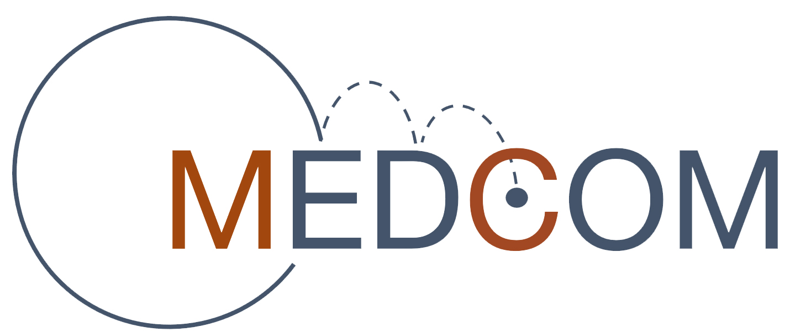
MedCom – The company that facilitates communication between healthcare and technology
The bridge between healthcare and technology
Healthcare
Technology
MedCom
Product description
Use case demo
User test results
Summary
Notes:
My name is Axel and this is my colleague David and together with 20 more students we represent MedCom.
MedCom is a software development company with employees from highly relevant and high quality educations. We are a diversified group of students with a passion for software development and an integral progressive mindset. As of now the main focus is in combining technology and healthcare and we strive for useful and meaningful results. MedCom – A bridge between healthcare and technology.

Slide 6




Intuitive UI that facilitates critical and stressful situations
User-Interface based on conducted user-tests
Clear focus on functionality
Known and consistent features on each step of the process
Customizable styling to match your graphical profile
Progress bar
INTUITIVE
RELIABLE
FAST
MedCom
Product description
Use case demo
User test results
Summary
Notes:
We have developed an intuitive UI that facilitates critical and stressful situations based of of several user-tests in different stages of development. And what we found were important in these situations.
A clear and precise focus on vital functionality.
We also want known and consistent features wherever you are on the site. Today one instinctively recognize and expects certain parts of any website to work in a certain way and we have incorporated many of these to make the end user feel comfortable, which you will see more of in the demo.
We have made it very easy to style the graphical profile of the page according to your preferences. This is to make sure that the page fits your target audience so that they feel again comfortable.

Slide 7

Fast and responsive single page application with a 3-step process from initiation to completion
3-step process from page load to image transfer
Early validation to avoid wrong information and repeated steps
Single page application only rendering necessary components
INTUITIVE
RELIABLE
FAST
MedCom
Product description
Use case demo
User test results
Summary
Notes:
3-step process! Add contact information and upload the picture. Verify that the information is correct and make sure the quality of the picture is ok. Authenticate yourself and send the information. It’s that easy.
Already in the first step the application will perform a validation check to make sure that your contact info is inputted in the correct format. It is very clear for the user whether or not everything is in order because if not the input field is highlighted and you cannot proceed. This of course saves unnecessary time being spent on redoing the steps if you later on notice you’ve missed a number.
We also check to see that the picture or pictures are a valid size. Too small and it won’t have the necessary resolution. This to eliminate unnecessary back and forth communication because the information is incomplete.
It is a single page application, ensuring that only the necessary content of the page is updated when visiting a different part of the site. This significantly reduces the page load time.

Slide 8

Implementing user validation for security and integrity
Both input and user validation
Secures that relevant and correct information is sent
Preventing spam and miss usage
Restores integrity and security to both end-user and service provider
INTUITIVE
RELIABLE
FAST
MedCom
Product description
Use case demo
User test results
Summary
Notes:
As I’ve mentioned, input validation. But also User validation. The user has to authenticate themselves against Region Östergötland via BankID as it is right now providing a level of security and professionalism. This is appreciated by the sender and receiver side of the application as well as the service provider.
One has to authenticate themselves both when first creating and sending an errand but also when retrieving an old errand to supplement it.
Like I said, the application will handle very sensitive information and by demanding authentication not only to send but to retrieve we ensure No Data Tampering!

Slide 9

A modern application built on acknowledged software, easing implementation and optimizing for scalability
Modern and recognized framework
Developed through modular programming
Integratable with the FileCloud service
Mobile-first responsive Bootstrap styling
MedCom
Product description
Use case demo
User test results
Summary
Notes:
Now that Axel have talked about the product functionality from the perspectives Intuitive, fast, and reliable, I will go talk a little bit about how our product is buildt and the business advantages that this brings.
First of all we have used the modern and recognized framework Angular 2+.
This have allowed us to develope our application through modularprogramming, making out source code
Ändra denna bild! Borde inte vara en bild på arkitekturen, istället mer säljig.
Why Intuitive
Why Fast
Why Reliable
Developed in Angular
Modular
Integrates with file sharing tools
FileCloud
Easy to implement
Easy to use

Slide 10



Three simple steps for creating and sending a case
Burn Injury
Case Creation
Upload case to FileCloud
MedCom
Product description
Use case demo
User test results
Summary
Notes:
ATT TRYCKA PÅ
Direkt respons vid formulärfel
Progress-bar som visar var i processen du är
Hämta ärende info faxades innan

Slide 11
End-User Feedback
.
Very handy application, it’s clear that it will be useful
93,3 out of 100 in SUS-test
4,67 out of 5 in professionality
4,33 out of 5 in overall rating
.
The application was simple to use
Applicable on other medical areas
MedCom
Product description
Use case demo
User test results
Summary
Notes:
We conducted tests on doctors.
One of them was the SUS (system usability scale) -test where we received a score of 93,3 our of 100, where a score over 90 is considered excellent.
We also asked the doctors to rate the professionality and overall rating on the application from a scale from 1 to 5 and we received 4,67 on professionality and 4,33 in overall rating.
Users have seen potentials in using the product in other areas than for burn injuries as well:
- Plastic surgery
- Oral and maxillofacial surgery
- Chiroplasty and orthopedic surgery
Some other comments we revieced on the application:
“The application was simple to use”
”Very handy application, it’s clear that it will be useful”

Slide 12
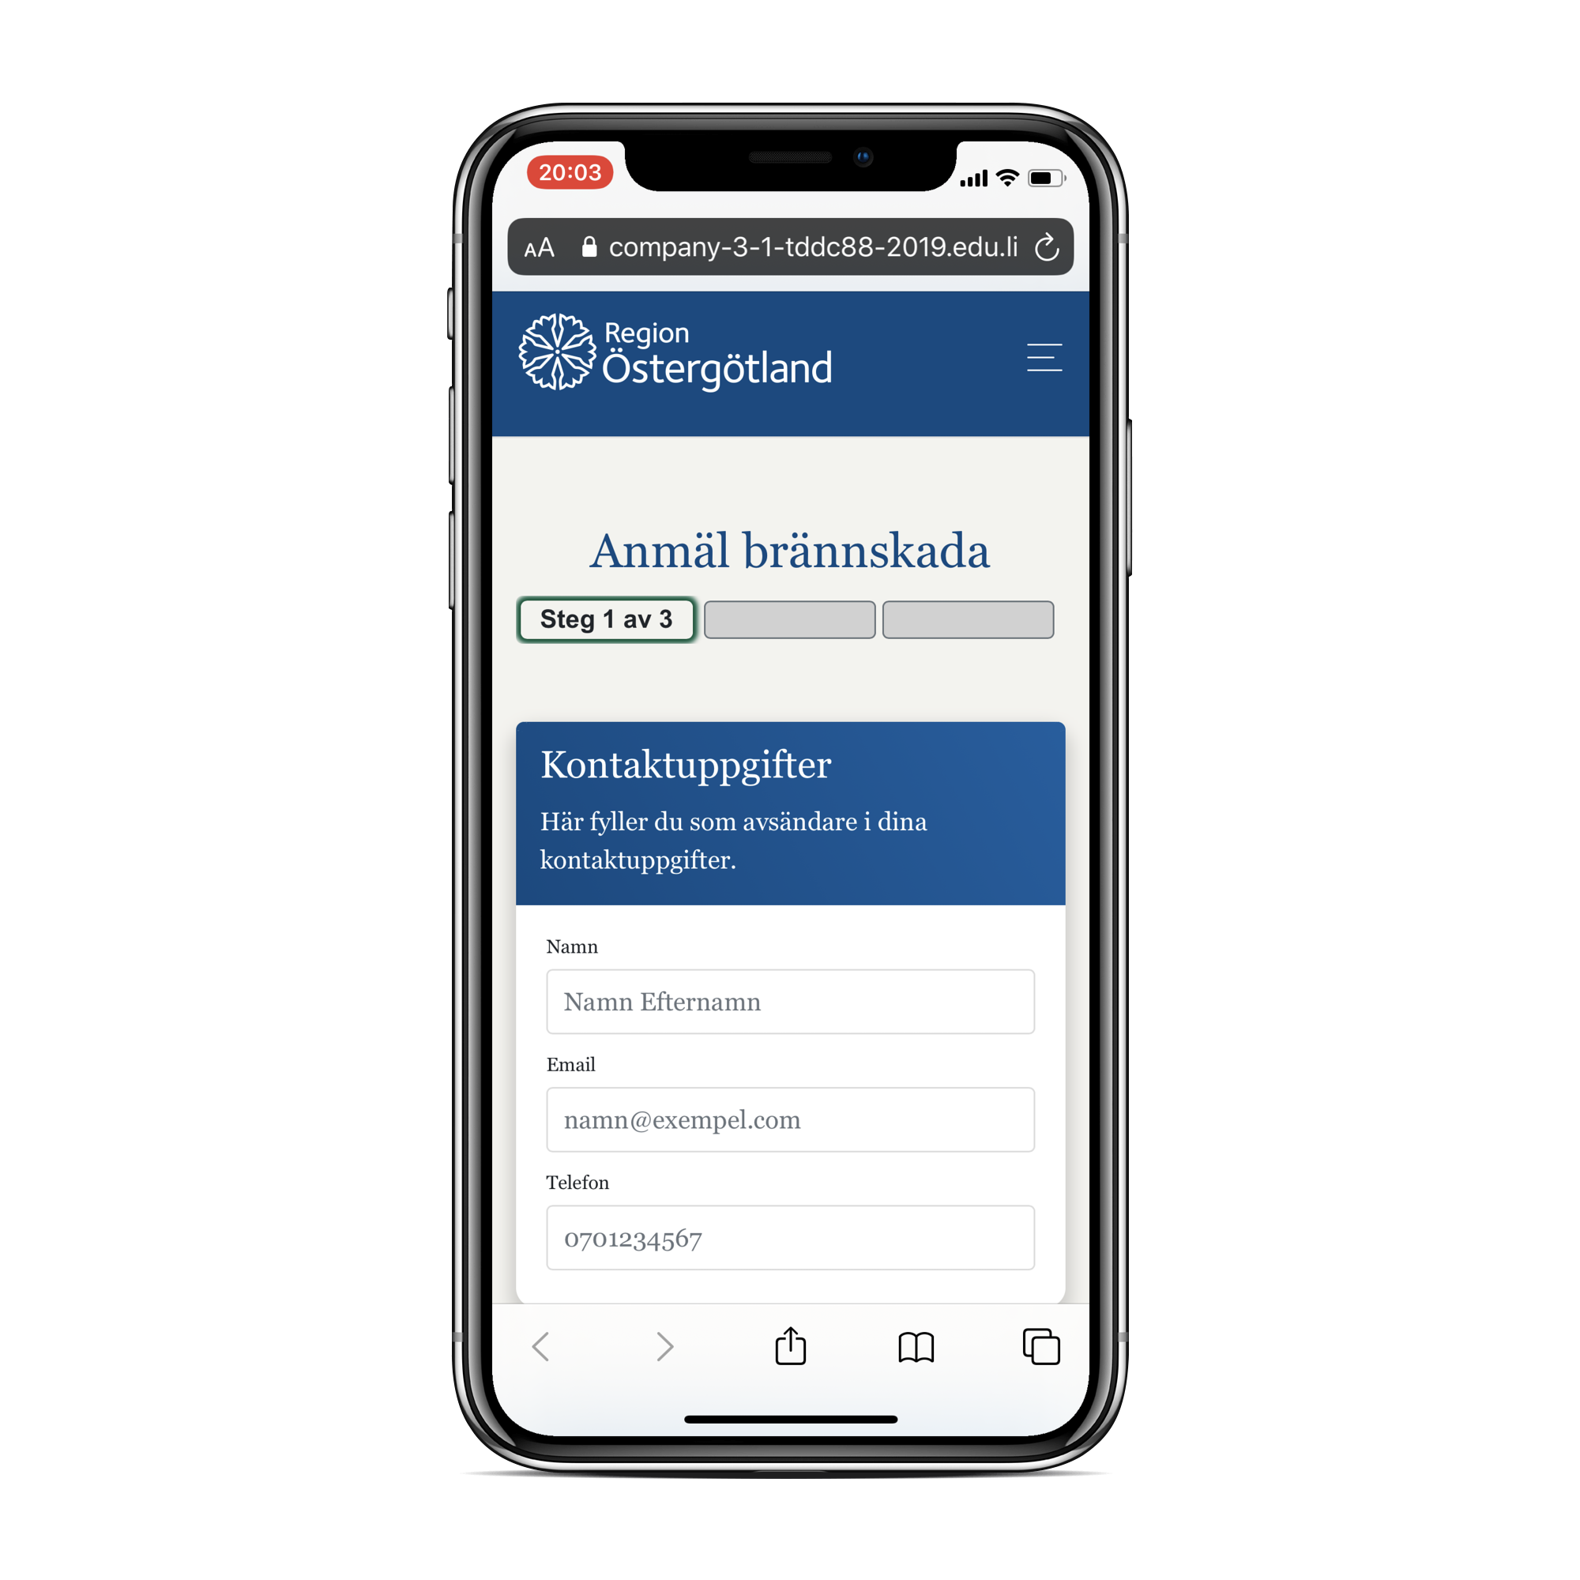
Summary
Intuitive, fast and reliable
Expandable product
Great potential for more medical areas
Positive response from test users
MedCom
Product description
Use case demo
User test results
Summary
Notes:
In conclusion, you might be tired of hearing but… We’ve got a product that is Intuitive, fast and reliable! We have built it using modern and recognizable frameworks that has allowed us to make it modular. Therefore it has great potetial of being much more than it is right now. Response from end users have been great and they confirm the potential for more medical areas of use! Thank you for listening

Slide 13
Summary
”The bridge between healthcare and technology”
MedCom
Product description
Use case demo
User test results
Summary
Notes:
And thank you from the entire MedCom

